Slide 1

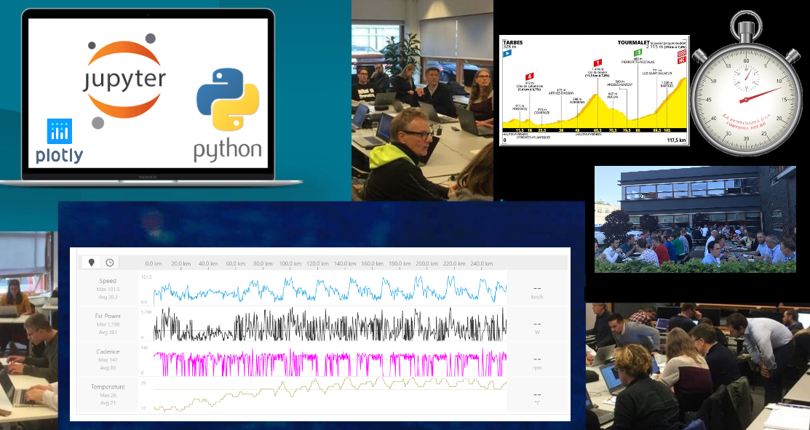
AMIS MeetUp Value and Fun of Time Series Visualization & Analytics
September 2019

Slide 2
Overview
Introduction Time Series
Loading, Wrangling & Visualizing Time Series Data
Working on Strava performance data for contenders in the Tour de France 2019
Analyzing patterns and frequencies in Time Series
Inspecting Twitter timestamps for Tweeter
Finding and Using Similarity in ordered Data Series
Letter frequency for Language Detection
Creating and comparing ‘serie fingerprints’
Dinner
Hands-on
AGENDA

Slide 3
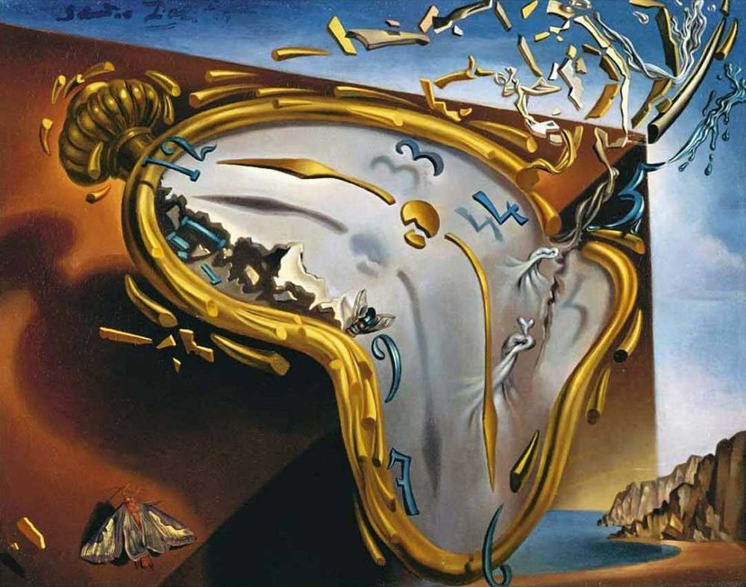
Introducing Time Series
Observations with a timestamp
Timestamp can refer to brief moment or longer period (minute, hour, day, month, year)
Observation can be simple scalar measurement or an aggregate over a period (sum, count, average, max, min, …)
An observation can be multidimensional – a combination of values
Examples
Blood pressure, Notes on a musical bar, Daily (High | Low) Temperature, Number of steps per day, Body weight (measured each day | week), Calory intake, # lunches eaten per day, average speed on road section measured every 2 minutes, # website visitors per hour, power consumption per minute, daily number of visitors of the Louvere
Almost all IoT data can be regarded as a time series

Slide 4
What are Time Series?
25.1750
25.2250
25.2500
25.2500
25.2750
25.3250
25.3500
25.3500
25.4000
25.4000
25.3250
25.2250
25.2000
25.1750
..
..
24.6250
24.6750
24.6750
24.6250
24.6250
24.6250
24.6750
24.7500
A time series is a collection of observations made sequentially in time.
29
28
27
26
25
24
23
0
50
100
150
200
250
300
350
400
450
500
created by: Jessica Lin and Eamonn Keogh

Slide 5
Time Series are Ubiquitous! I
People measure things...
Schwarzeneggers popularity rating.
Their blood pressure.
The annual rainfall in New Zealand.
The value of their Yahoo stock.
The number of web hits per second.
… and things change over time.
Thus time series occur in virtually every medical, scientific and businesses domain.
created by: Jessica Lin and Eamonn Keogh

Slide 6
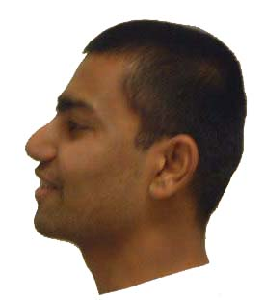
Image data, may best be thought of as time series…
created by: Jessica Lin and Eamonn Keogh

Slide 7
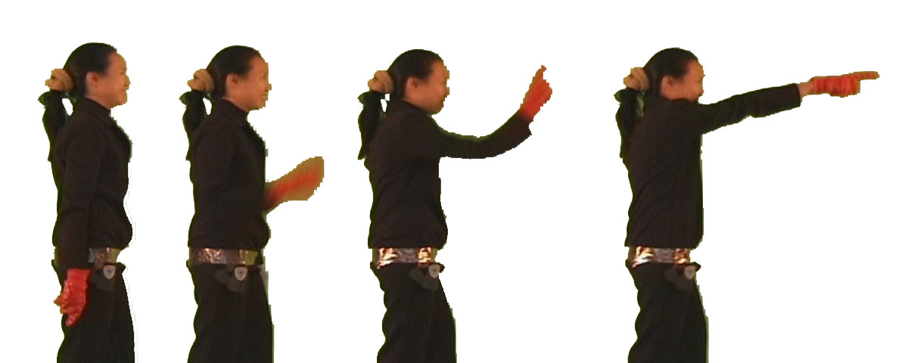
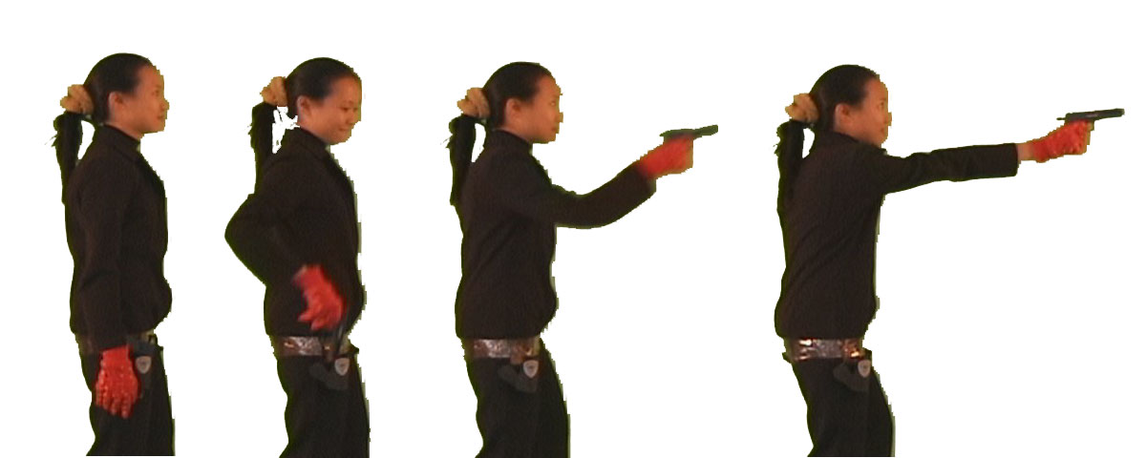
Video data, may best be thought of as time series…
Steady pointing
Hand moving to shoulder level
Point
Hand at rest
0
10
20
30
40
50
60
70
80
90
Steady pointing
Hand moving to shoulder level
Hand moving down to grasp gun
Gun-Draw
Hand moving above holster
created by: Jessica Lin and Eamonn Keogh
Hand at rest
0
10
20
30
40
50
60
70
80
90

Slide 8
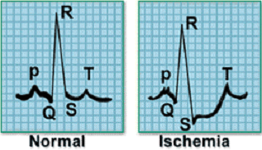

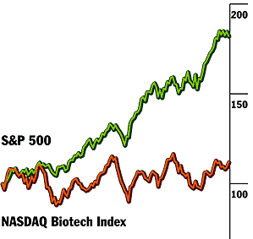

What do we want to do with the time series data?
Clustering
Classification
Motif Discovery
Rule Discovery
Query by Content
10
⇒
s = 0.5
c = 0.3
Novelty Detection
created by: Jessica Lin and Eamonn Keogh

Slide 9
All these problems require similarity matching
Clustering
Classification
Motif Discovery
Rule Discovery
Query by Content
10
⇒
s = 0.5
c = 0.3
Novelty Detection
created by: Jessica Lin and Eamonn Keogh

Slide 10
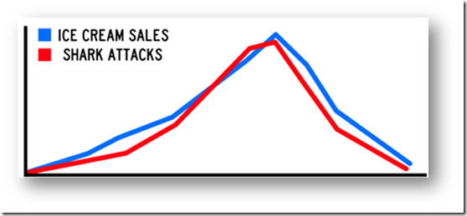
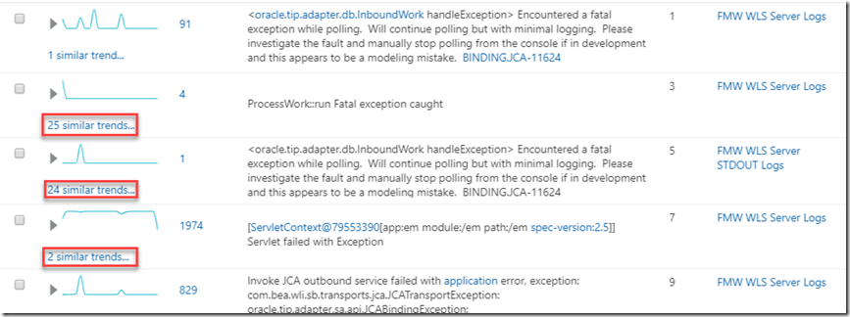
Similarity

Slide 11
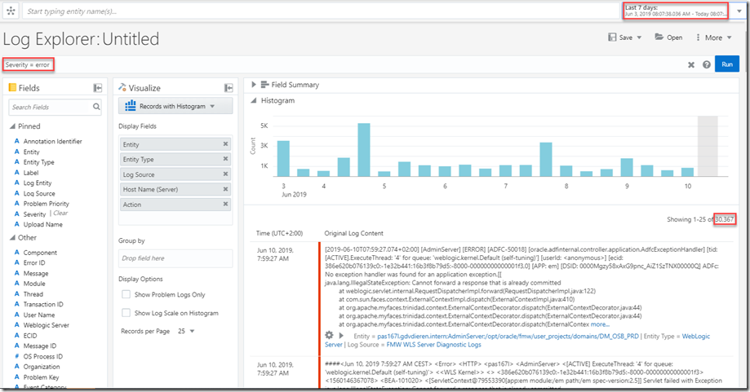
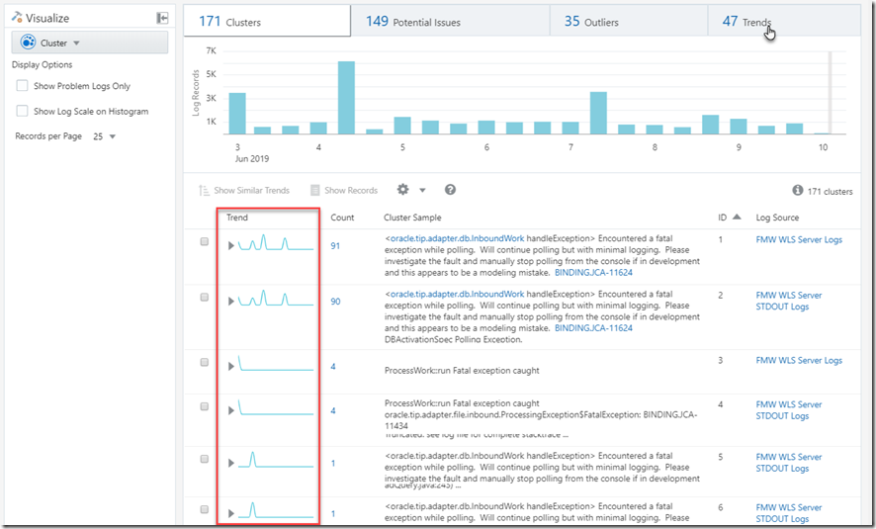
Power of Similarity in Log File Analysis
Individual Observations (log entries)
Clustered by Pattern – counted by time window
Grouped by ‘count per time window signal similarity’

Slide 12
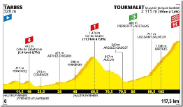
Ordered Data Series
Most approaches and techniques for processing, analyzing and visualizing Time Series also apply to other ordered data series
Altitude with distance, letters in a document, molecules in a DNA sequence, answers in a multiple choice test, Lap time for each lap in a Formula One Race

Slide 13
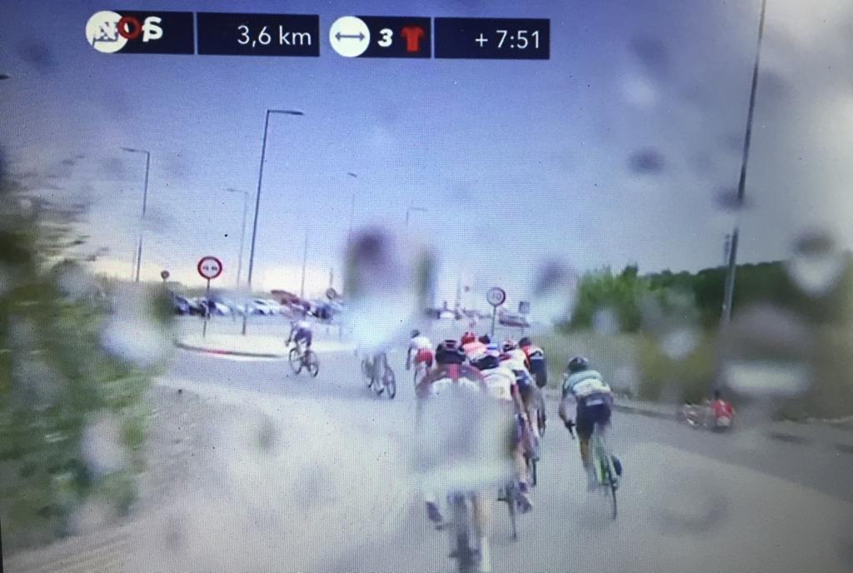
Tour de France 2019
Live Time Difference between front runner and main pack
GPS & Timestamp series for each rider? Or for TV motor bike?
Compare Timestamps for similar GPS?
Investigate detailed race data
Visualize location and time gap throughout the race
Create ‘Race Simular’ – emitting events with GPS and timestamp
Streaming Analysis on events received
Determine gaps at any moment
Detecting foul play (cut off, taxi ride)
Detecting crashed riders

Slide 14
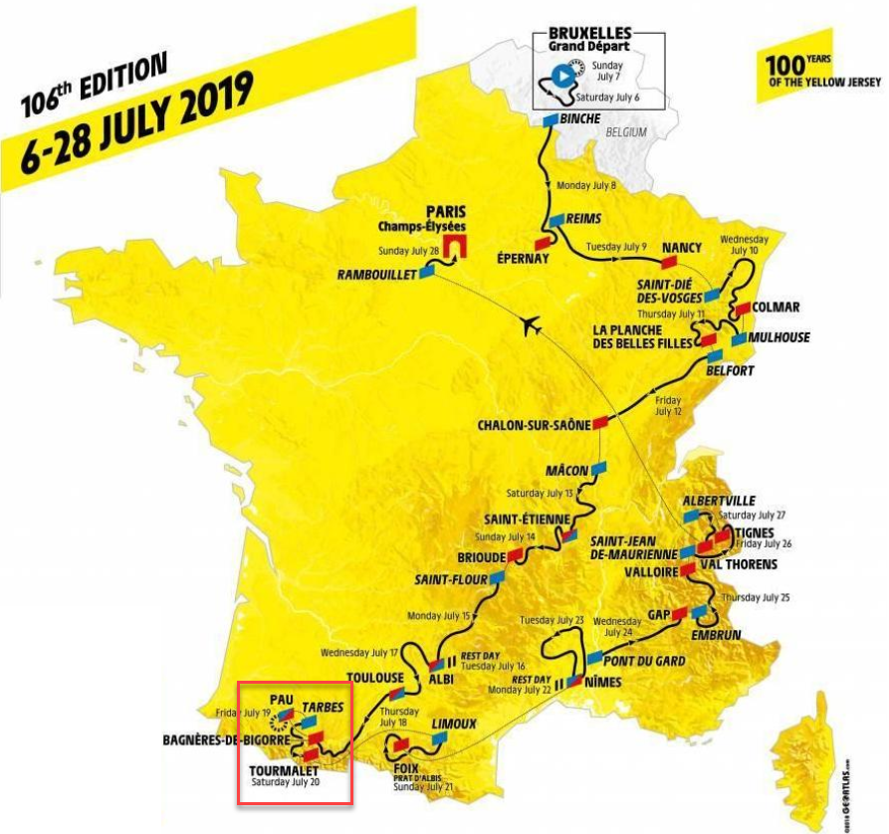
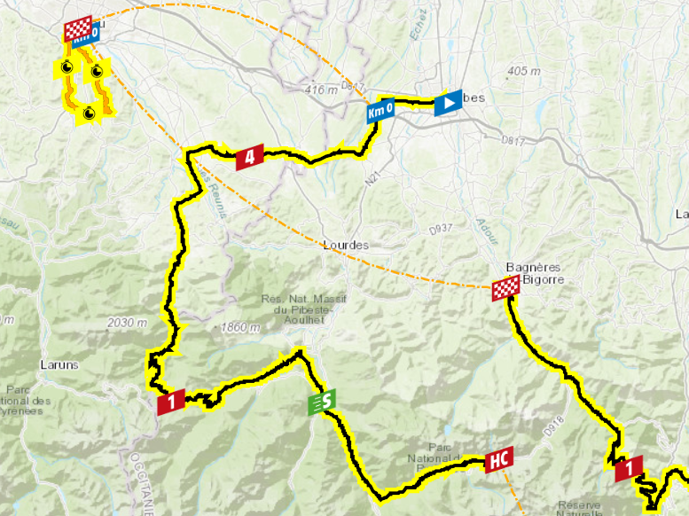
Stage 14 in Tour de France 2019
14
Notes:
https://www.letour.fr/en/stage-14

Slide 15
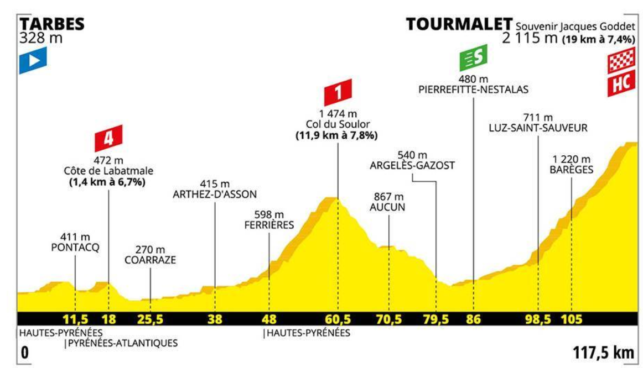
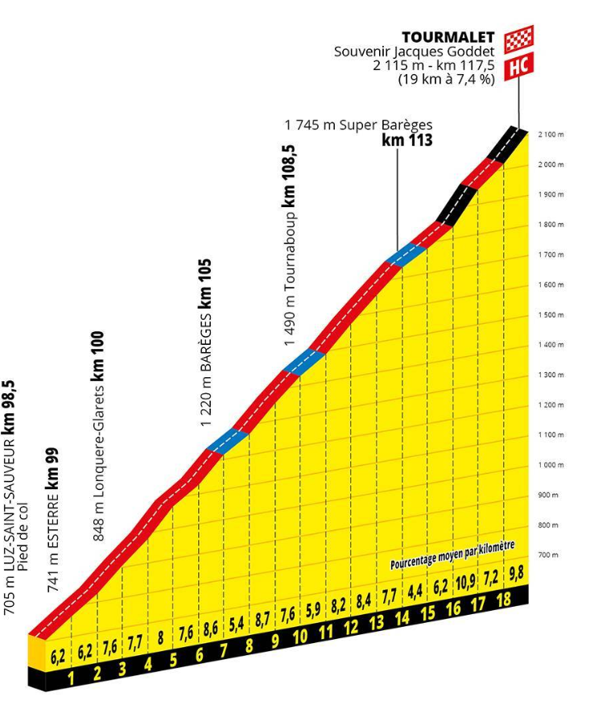
Stage 14 in Tour de France 2019
Final Climb
Notes:
https://www.letour.fr/en/stage-14

Slide 16
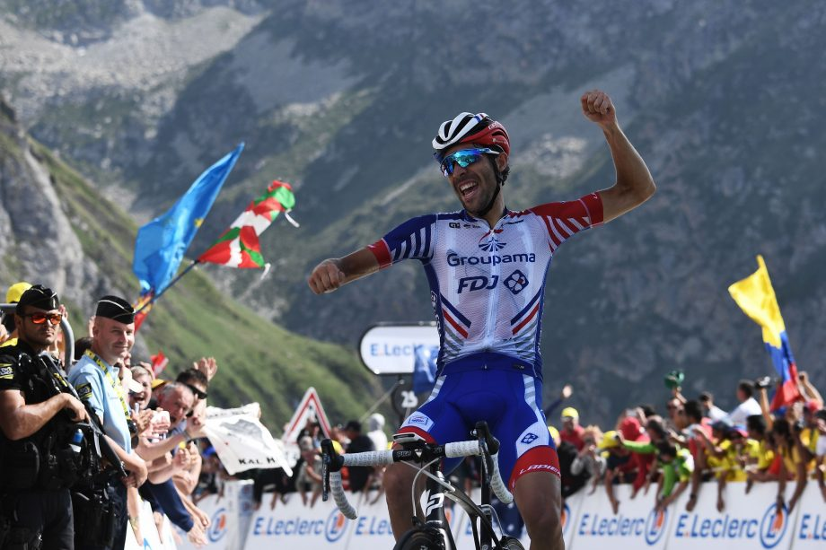
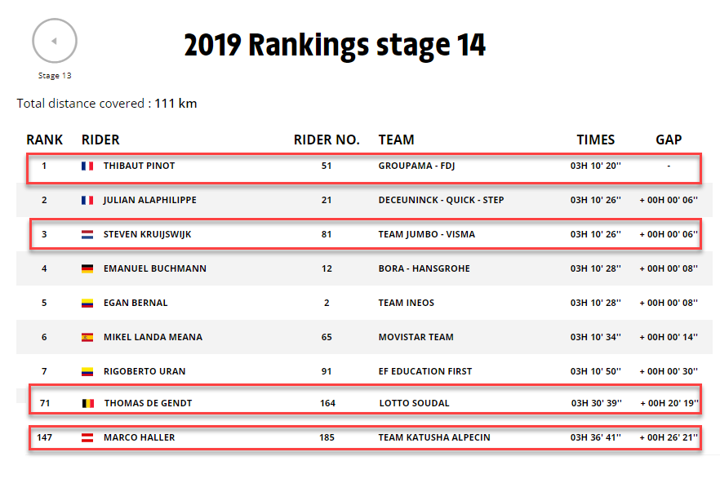
Stage 14 in Tour de France 2019
Notes:
https://www.letour.fr/en/stage-14

Slide 17

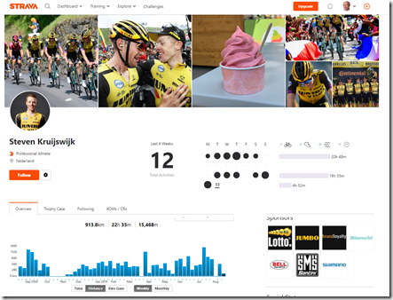
Strava – Platform for Activity Metrics
Anyone can upload their activity metrics
From GPS devices, Garmin, Mobile App
Strava helps to visualize, analyze and to compare
Gamification of athletic activity – strife for improvement
Metrics include: Time, Location, Distance, Altitude, Temperature, Speed, Cadence, Gradient,
Many professional cyclists share their data on Strava

Slide 18
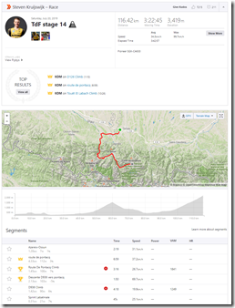
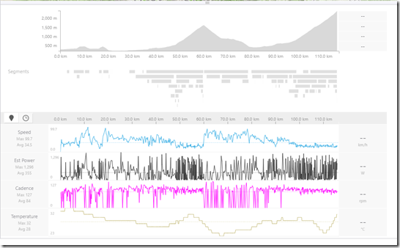
Strava Activity
Stage 14 in the Tour de France 2019
Notes:
https://www.strava.com/activities/2548396565

Slide 19
Strava Data Download
Strava API only can access data for which explicit authorization has been given
Your own data, Data shared to you or Data owned by a user who authenticates the App accessing the API
(some form of the) Strava API is also used by Web Application
When I am authenticated in the browser, I can browse through public data from riders such as Steven Kruijswijk
This data is retrieved by my browser through REST API calls that return raw JSON data
I can manipulate and reissue those requests with custom query parameters; this gives me the JSON data I want in my browser
Just copy and paste to text file to turn this data into processable chunks

Slide 20
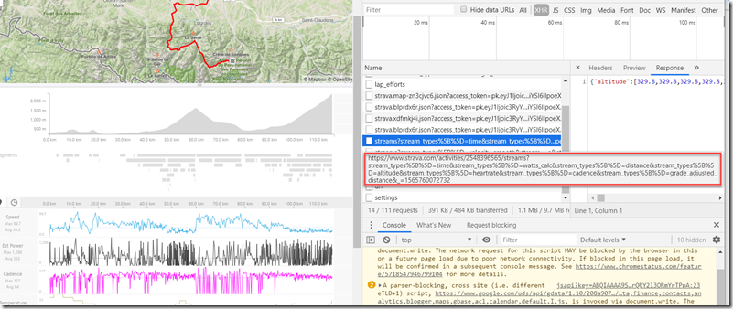
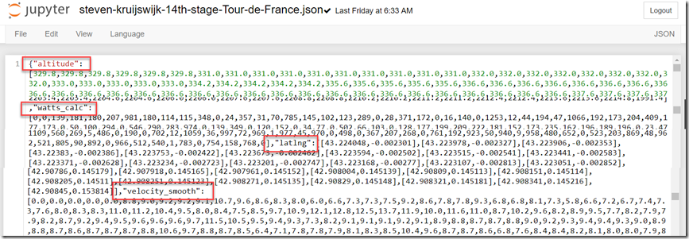
Strava Data Download
https://www.strava.com/activities/2548396565/streams?stream_types%5B%5D=time&stream_types%5B%5D=velocity_smooth&stream_types%5B%5D=watts_calc&stream_types%5B%5D=altitude&stream_types%5B%5D=heartrate&stream_types%5B%5D=cadence&stream_types%5B%5D=temp&stream_types%5B%5D=distance&stream_types%5B%5D=latlng&stream_types%5B%5D=grade_smooth&_=1565273406470

Slide 21


Load, Explore, Visualize
Technology Stack
Jupyter Notebooks
Python
Pandas
Plotly
Show:
Distance with Time
Altitude with Time
Altitude with Distance

Slide 22

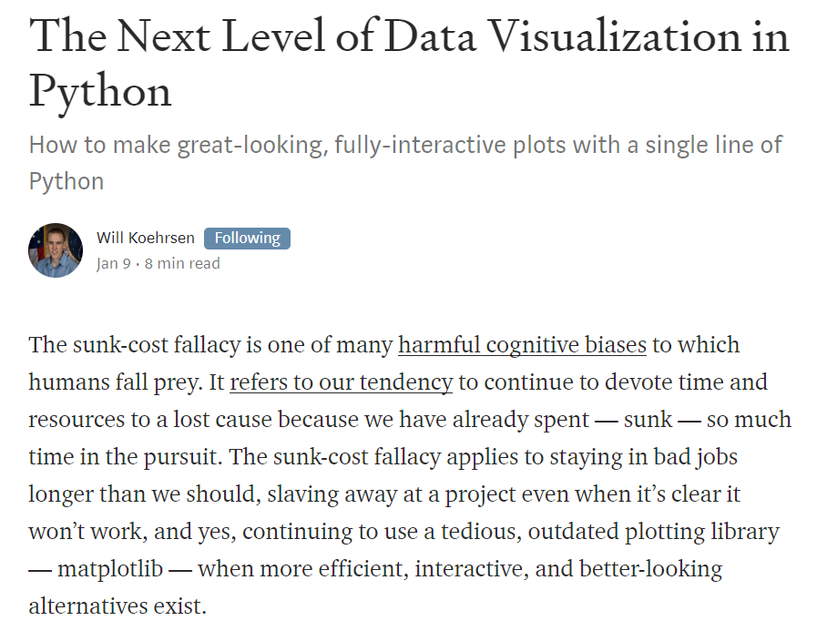
Plotly and Plotly Express
Based on plotly,js that is based on D3.js
Plotly Express is simple declarative wrapper for 80% of use cases
Has many, many types of interactive plots
Supports advanced features such as animation, 3D, annotations and has online Plotly Studio
Support for Time Series

Slide 23
Combine Multiple Riders’ data to tell the race story
Multi-line plot
Finding: data is not aligned
Strava start recording at different time and place
How to align?
Use reference points
GPS
Altitude
Determine relative time or distance for each rider compared to Thibaut
Realign data by applying time and distance shift
Altitude shift? (Steven’s altitude is special)

Slide 24
Plot Time Gap vs Thibaut at any point during the race
Also show Altitude
This shows the early get away group with Marco Haller
And the slow but sure agony of Thomas and especially Marco

Slide 25
Patterns and Frequencies
Tweets timestamps for an author
Visualize
Resample
Per hour, day, week
Find seasonality – repeated pattern over year
Find frequency through week or day
Find out where the author lives
By looking at slowest 5 hours – probably corresponding to sleep and therefore nighttime in author’s time zone
When did she or he travel – and where
when did Tweets happen during the ‘sleep time’ – and when was the apparent sleep time in that period?
Bot or Person?

Slide 26
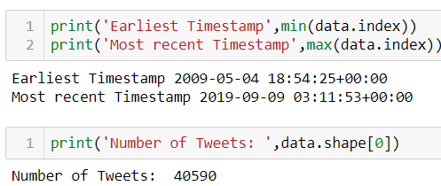
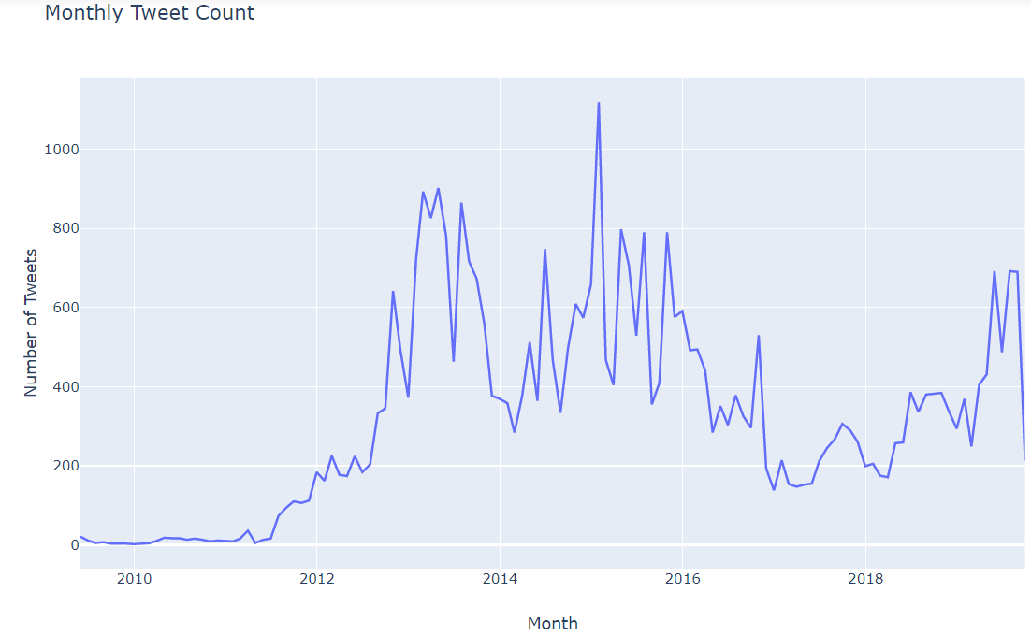
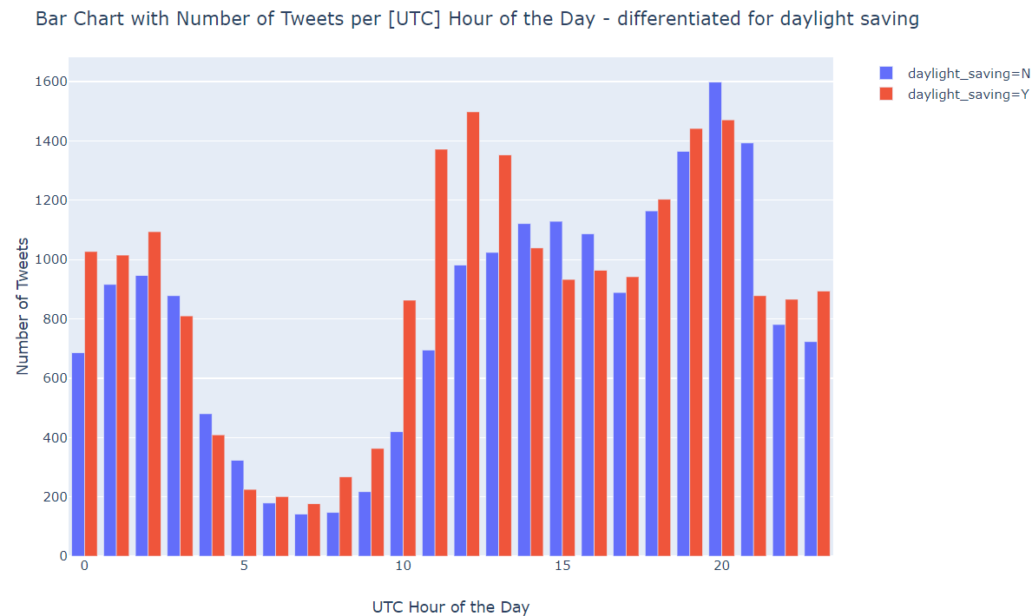
Twitter Analysis

Slide 27
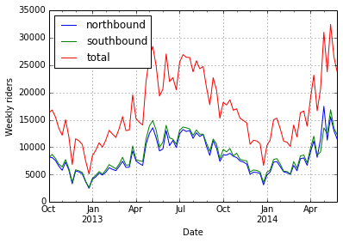
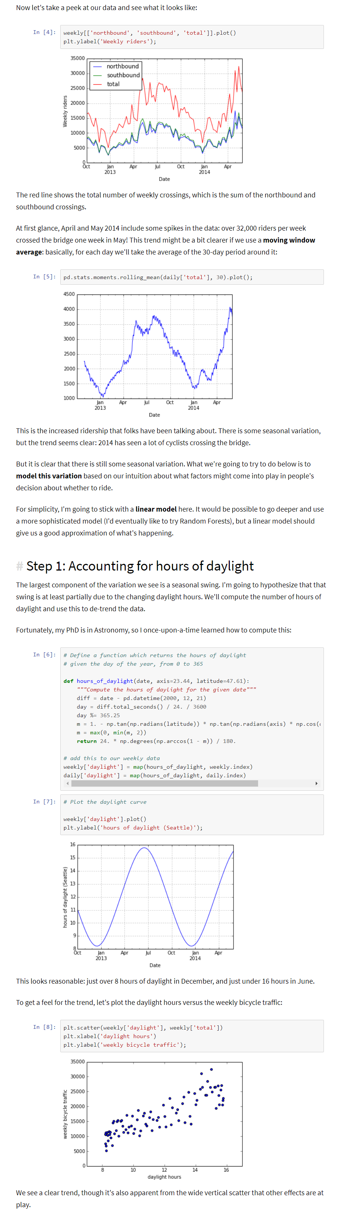
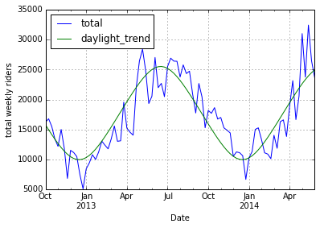
Example of Timeseries Data Exploration: Seattle Bicycle count
https://jakevdp.github.io/blog/2014/06/10/is-seattle-really-seeing-an-uptick-in-cycling/
Notes:
https://jakevdp.github.io/blog/2014/06/10/is-seattle-really-seeing-an-uptick-in-cycling/
https://jakevdp.github.io/blog/2015/07/23/learning-seattles-work-habits-from-bicycle-counts/

Slide 28

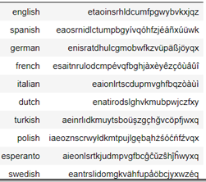
Language Detection

Slide 29
Detect Document Language based on Letter Frequency Sequence
Determine letter frequencies for [snippet of] unknown document
Order letters by their frequencies into a letter sequence
Compare the resulting sequence to the language reference sequences and find the one that is most similar
Use Levenshtein distance for comparing sequences
Short -cut alternative for more advanced classification approaches
Extremely fast
Very simple
Not 100%reliable – but quite good [initial] results

Slide 30
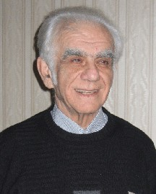
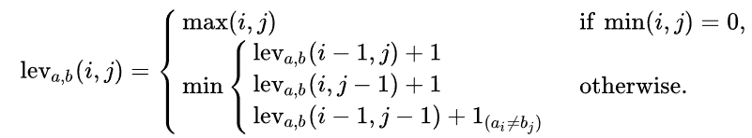
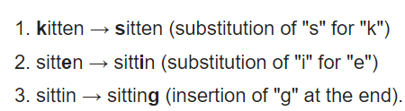
Levenshstein Distance
Assign costs to edit-operations that are required to turn one string into another
Add
Replace
Delete
Example: determine Levenshtein Distance between kitten and sitting
Notes:
https://en.wikipedia.org/wiki/Levenshtein_distance
https://medium.com/@ethannam/understanding-the-levenshtein-distance-equation-for-beginners-c4285a5604f0

Slide 31
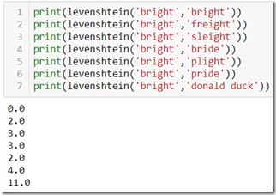
Levenshstein Distance
Assign costs to edit-operations that are required to turn one string into another
Add
Replace
Delete
Example: determine Levenshtein Distance between kitten and sitting
Notes:
https://en.wikipedia.org/wiki/Levenshtein_distance
https://medium.com/@ethannam/understanding-the-levenshtein-distance-equation-for-beginners-c4285a5604f0

Slide 32
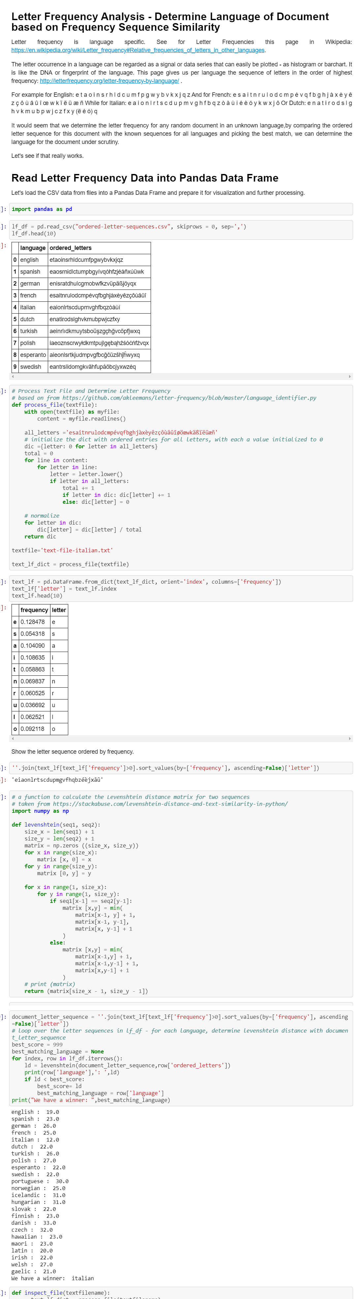
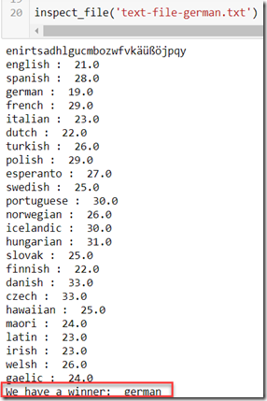
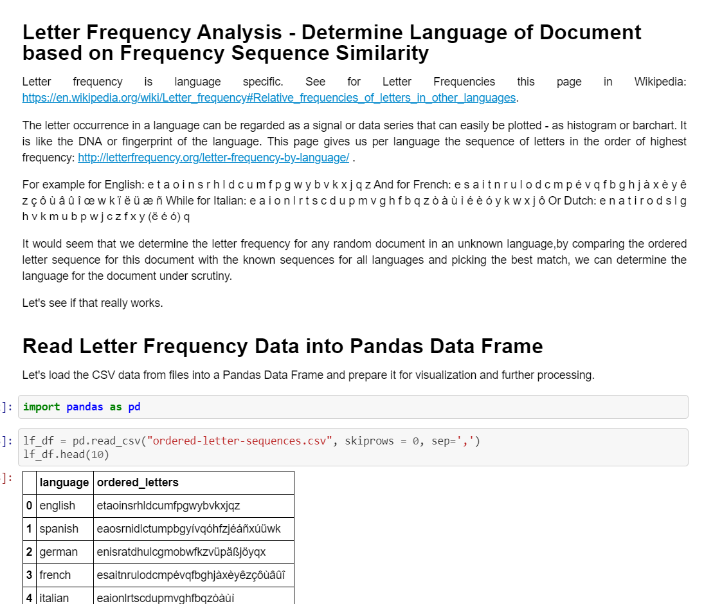
The Jupyter Notebook
Notes:
https://technology.amis.nl/2019/08/21/determine-the-language-of-a-document-from-the-letter-frequency-using-levenshtein-distance-between-sequences/

Slide 33
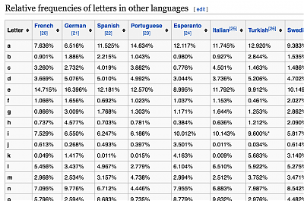
Letter frequency signal is Language Fingerprint
Ordered Data Series
More subtle method for determining language for document
Create fingerprint for document – based on letter frequencies
Compare fingerprint with all reference fingerprints and find most similar one
How to calculate distance?
Simple: Euclidean
Not fast at scale
Assigns too much importance to noise and detail

Slide 34
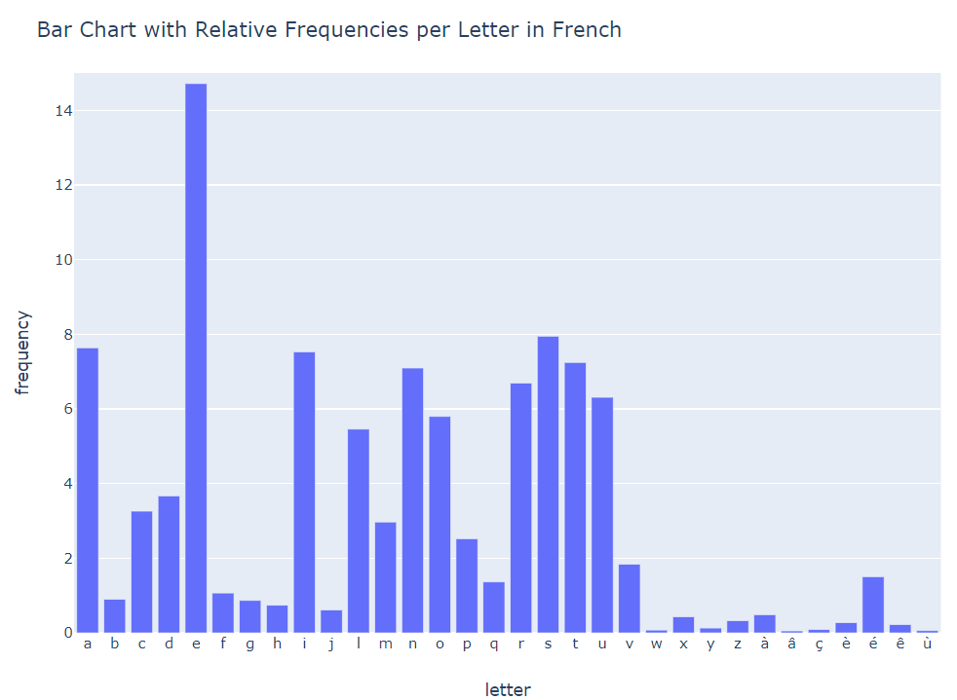
Letter Frequency Signal = Language Fingerprint
Show bar chart for French

Slide 35
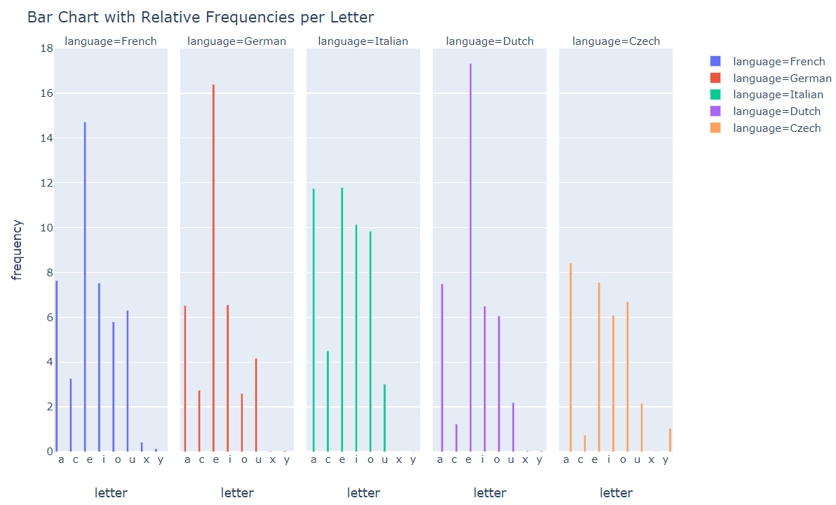
Letter Frequency Signal = Language Fingerprint
Show bar chart for multiple languages

Slide 36
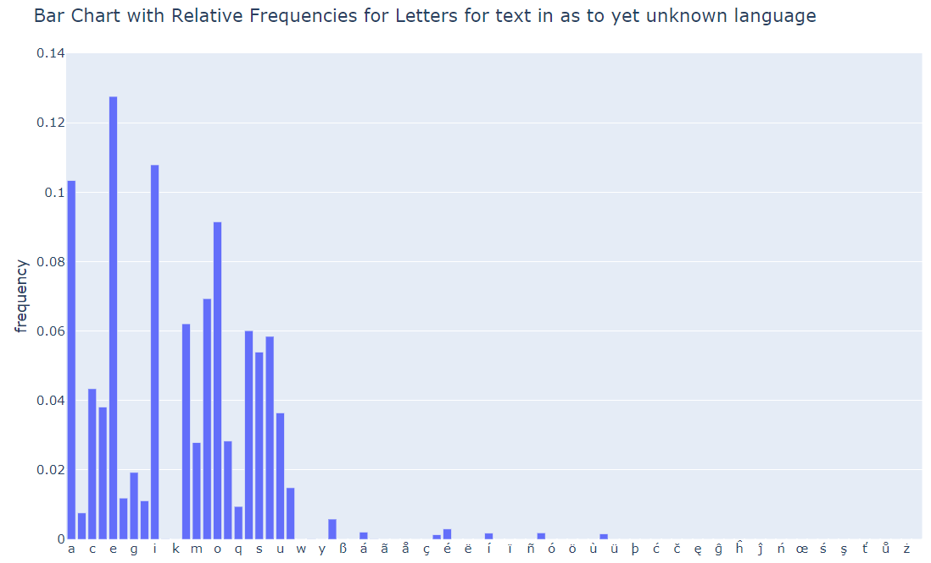
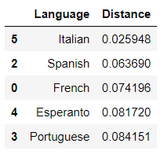
Language Detection for Unknown Document
Determine Letter Frequency Signal Fingerprint for document
Find best matching reference fingerprint =>similarity!

Slide 37
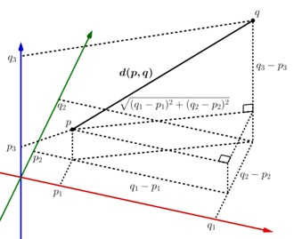
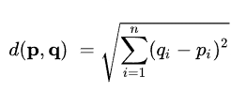
Euclidean Distance
Pythagoras – in multiple dimensions
For each letter, take the square of the difference in frequency values – then sum all outcomes together and take the overall square root

Slide 38
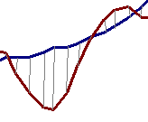
Euclidean Distance Metric
Given two time series
Q = q₁…q_{n}
and
C = c₁…c_{n}
their Euclidean distance is defined as:
C
Q
D(Q,C)
created by: Jessica Lin and Eamonn Keogh

Slide 39
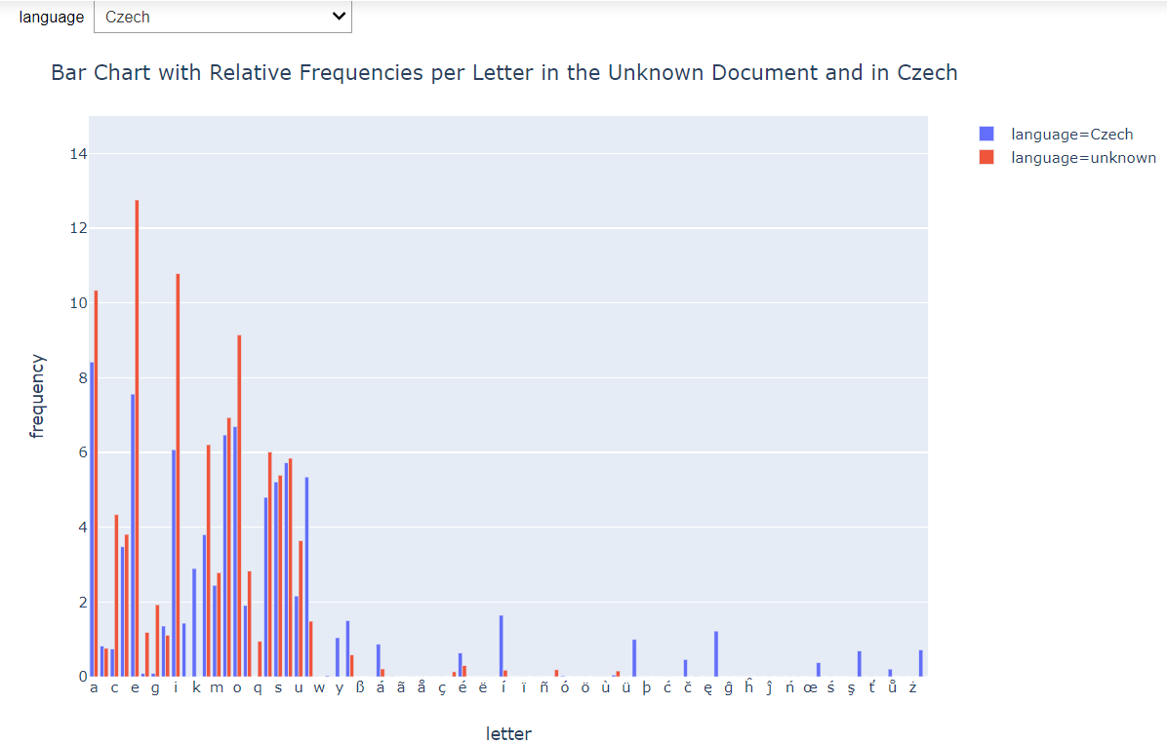
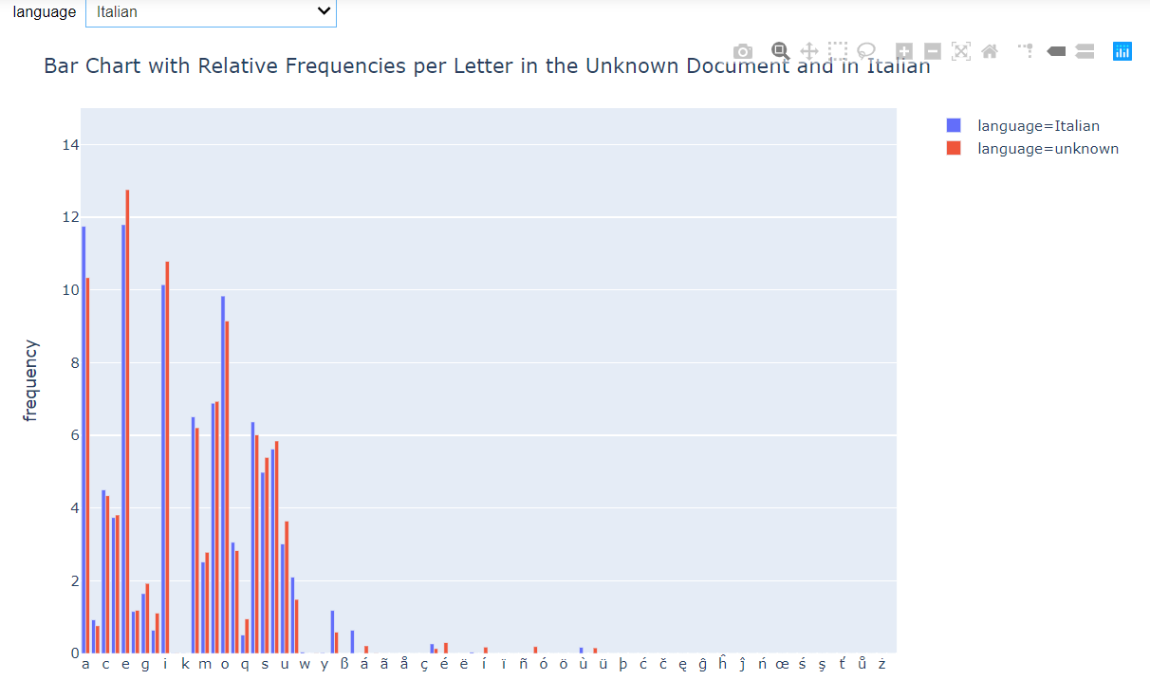
Euclidean Distance == Sum of Area Differences in Bar Chart

Slide 40
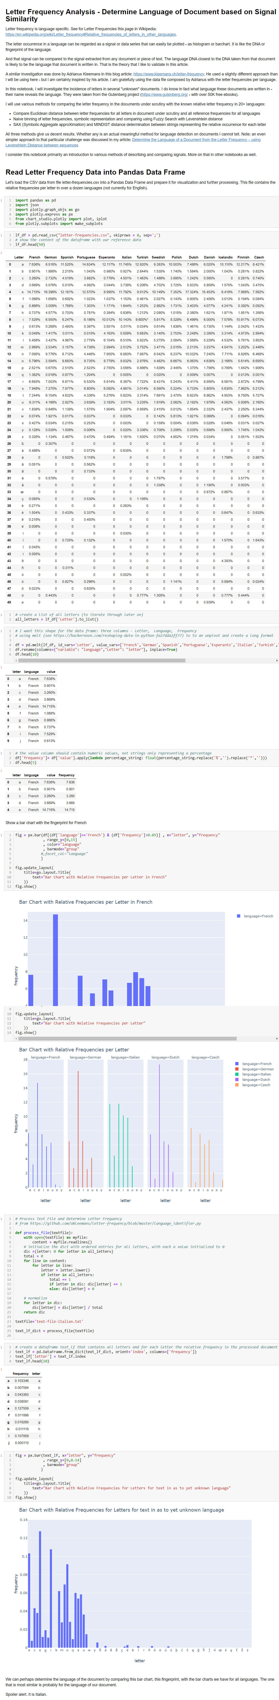

Jupyter Notebook
Detect language by Letter Frequency Signal comparison

Slide 41
Similarity
How to determine similarity?
What is similar – in a meaningful way?

Slide 42
Compare these two – which one is the longest?
13.432,28
40.172,71

Slide 43


To compare things, you do not need all details
Depending on what you are comparing on or looking for

Slide 44

Reduced Dimensionality of Data Series
For finding similarity – we can get very good and fast results when working with reduced dimensionality - lower resolution, fewer data points and less noise
Faster processing of larger data sets
Potentially better results
Piecewise Aggregate Approximation (PAA) – discretize in fixed size windows and determine average value

Slide 45

Symbolic Representation of Data Series
For finding similarity – we can get very good and fast results when working with a symbolic representation of series and a fairly crude distance calculation
Piecewise Aggregate Approximation – discretize in fixed size windows and average value

Slide 46


Symbolic Representation is often good enough

Slide 47






Are all T-Shirts created equal?

Slide 48
What is lower bounding?
Exact (Euclidean) distance D(Q,S)
Lower bounding distance D_{LB}(Q,S)
Q
Q’
S
S’
D(Q,S)
D_{LB}(Q’,S’)
D(Q,S)
D_{LB}(Q’,S’)
Lower bounding means that for all Q and S, we have…
D_{LB}(Q’,S’) ≤ D(Q,S)

Slide 49
We have created the first symbolic representation of time series, that allows…
Lower bounding of Euclidean distance
Dimensionality Reduction
Numerosity Reduction

Slide 50




Similarity of Time Series
Notes:
https://hal.archives-ouvertes.fr/hal-00689890/document

Slide 51

We call our representation SAX Symbolic Aggregate ApproXimation
baabccbc

Slide 52

How do we obtain SAX?
C
C
0
20
40
60
80
100
120
First convert the time series to PAA representation, then convert the PAA to symbols
It take linear time
c
c
c
b
b
b
a
-
a
-
0
0
20
40
60
80
100
120
baabccbc

Slide 53

c
c
c
b
b
b
a
-
a
Time series subsequences tend to have a highly Gaussian distribution
-
0
0
20
40
60
80
100
120
Why a Gaussian?
A normal probability plot of the (cumulative) distribution of values from subsequences of length 128.

Slide 54

The Steps in SAX

Slide 55

https://beta.vu.nl/nl/Images/stageverslag-roelofsen_tcm235-882304.pdf

Slide 56
Determine Similarity from (logical) Distance
Distance is important in comparison used to determine similarity
Distance calculation is often expensive
Done very often
Requires floating point calculations
For comparison, we do not need the exact distance
A good approximation is good enough
There are many ways to measure similarity (calculate distance)
Levenshtein, Euclidean, PAA (based Euclidean)
MINDIST

Slide 57

https://beta.vu.nl/nl/Images/stageverslag-roelofsen_tcm235-882304.pdf

Slide 58

1.5
C
1
0.5
Euclidean Distance
0
-
0.5
-
1
Q
-
1.5
0
20
40
60
80
100
120
1.5
C
1
PAA distance lower-bounds the Euclidean Distance
0.5
0
-
0.5
-
1
Q
-
1.5
0
20
40
60
80
100
120
ˆ
=
baabccbc
C
dist() can be implemented using a table lookup.
ˆ
=
babcacca
Q

Slide 59



Slide 60



Slide 61

created by: Jessica Lin and Eamonn Keogh

Slide 62
http://www.facom.ufu.br/~elaine/disc/MFCD/time-series.pdf
Plaatjes van motif discovery, hot sax, DTW

Slide 63
Use SAX for Language Detection
Determine Language Fingerprint based on SAX representation of Letter Frequencies
Determine SAX Document Fingerprint for several documents
Calculate MINDIST with reference fingerprints and determine top 3 most likely languages
As a first guess – this works pretty well!
Note: alternative algorithm: Weighted Levenshtein in Similarity Search (fuzzy subsequence search in SAX string)
Make substition of adjacent symbols cheap compared to far removed symbols
Notes:
https://github.com/luozhouyang/python-string-similarity#levenshtein

Slide 64

Create SAX representation of letter frequencies

Slide 65

Calculate distance between SAX of unknown document and SAX of all languages and find shortest distance

Slide 66
SAX Representation of Stage in Tour de France

Slide 67

Matrix Profile
The Matrix Profile is a recently developed algorithm with the potential to revolutionize time-series analysis
It supports motif discovery, density estimation, anomaly detection, rule discovery, joins, segmentation, clustering
The Matrix Profile (MP) is a data structure that annotates a time series.
With the smallest distance with its nearest neighbor (most similar subsequence) and a reference to that neighbour
Notes:
https://matrixprofile.org/

Slide 68
The Highly Desirable Properties of the Matrix Profile I
• It is exact: For motif discovery, discord discovery, time series joins etc., the Matrix Profile based methods provide no false positives or false dismissals. • It is simple and parameter-free: In contrast, the more general algorithms in this space that typically require building and tuning spatial access methods and/or hash functions. • It is space efficient: Matrix Profile construction algorithms requires an inconsequential space overhead, just linear in the time series length with a small constant factor, allowing massive datasets to be processed in main memory (for most data mining, disk is death). • It allows anytime algorithms: While exact MP algorithms are extremely scalable, for extremely large datasets we can compute the Matrix Profile in an anytime fashion, allowing ultra-fast approximate solutions and real-time data interaction. • It is incrementally maintainable: Having computed the Matrix Profile for a dataset, we can incrementally update it very efficiently. In many domains this means we can effectively maintain exact joins/motifs/discords on streaming data forever.

Slide 69
The Highly Desirable Properties of the Matrix Profile II
• It can leverage hardware: Matrix Profile construction is embarrassingly parallelizable, both on multicore processors, GPUs, distributed systems etc. • It is free of the curse of dimensionality: That is to say, It has time complexity that is constant in subsequence length: This is a very unusual and desirable property; virtually all existing algorithms in the time series scale poorly as the subsequence length grows. • It can be constructed in deterministic time: Almost all algorithms for time series data mining can take radically different times to finish on two (even slightly) different datasets. In contrast, given only the length of the time series, we can precisely predict in advance how long it will take to compute the Matrix Profile. (this allows resource planning) • It can handle missing data: Even in the presence of missing data, we can provide answers which are guaranteed to have no false negatives. • Finally, and subjectively: Simplicity and Intuitiveness: Seeing the world through the MP lens often invites/suggests simple and elegant solutions.

Slide 70
Intuition behind the Matrix Profile: Assume we have a time series T
0
500
1000
1500
2000
2500
3000
|T | = n = 3,000

Slide 71
Note that for most time series data mining tasks, we are not interested in any global properties of the time series, we are only interested in small local subsequences, of this length, m
These subsequences might be about the length of individual heartbeats (for ECGs), individual days (for social media behavior), individual words (for speech analysis) etc
m = 100
0
500
1000
1500
2000
2500
3000

Slide 72
We can created a companion “time series”, called a Matrix Profile or MP.
The matrix profile at the i^{th} location records the distance of the subsequence in T, at the i^{th} location, to its nearest neighbor under z-normalized Euclidean Distance.
For example, in the below, the subsequence starting at 921 happens to have a distance of 177.0 to its nearest neighbor (wherever it is).
177
0
500
1000
1500
2000
2500
3000
921

Slide 73
Another example. In the below, the subsequence starting at 378 happens to have a distance of 34.2 to its nearest neighbor (wherever it is).
34.1
0
500
1000
1500
2000
2500
3000
378

Slide 74
We can create another companion sequence, called a matrix profile index.
The MPI contains integers that are used as pointers.
In the following slides we won’t bother to show the matrix profile index, but be aware it exists, and it allows us to find the nearest neighbor to any subsequence in constant time.
200
34.1
0
500
1000
1500
2000
2500
3000
1373 | 1375 | 1389 | … | .. | 368 | 378 | 378 | 234 | …
matrix profile index
(zoom in )

Slide 75
Note that the pointers in the matrix profile index are not necessarily symmetric.
If A points to B, then B may or may not point to A
An interesting exception, the two smallest values in the MP must have the same value, and their pointers must be mutual. This is the classic time series motif.
0
500
1000
1500
2000
2500
3000
1373 | 1375 | 1389 | … | .. | 368 | 378 | 378 | 234 | …
2000 | 2001 | 2002 | 2003 | 2003

Slide 76
How to “read” a Matrix Profile
Where you see relatively low values, you know that the subsequence in the original time series must have (at least one) relatively similar subsequence elsewhere in the data (such regions are “motifs” or reoccurring patterns)
Where you see relatively high values, you know that the subsequence in the original time series must be unique in its shape (such areas are “discords” or anomalies).
Must be an anomaly in the original data, in this region.
We call these Time Series Discords
0
500
1000
1500
2000
2500
3000
Must be conserved shapes (motifs) in the original data, in these three regions

Slide 77
How to “read” a Matrix Profile: Synthetic Anomaly Example
Where you see relatively high values, you know that the subsequence in the original time series must be unique in its shape. In fact, the highest point is exactly the definition of Time Series Discord, perhaps the best anomaly detector for time series*
Must be an anomaly in the original data, in this region
0
500
1000
1500
2000
2500
3000
* Vipin Kumar performed an extensive empirical evaluation and noted that “..on 19 different publicly available data sets, comparing 9 different techniques (time series discords) is the best overall technique.”. V. Chandola, D. Cheboli, V. Kumar. Detecting Anomalies in a Time Series Database. UMN TR09-004

Slide 78


Taxi Example: Part I
Given a long time series, where should you examine carefully?
The problem is called “Attention Prioritization”, a group at Stanford is working on this [a].
However we think that the Matrix Profile can be used for this, “for free”.
Below is the data, the hourly average of the number of NYC taxi passengers over 75 days in Fall of 2014.
Lets compute the Matrix Profile for it, we choose a subsequence length corresponding to two days…. (next slide)
500
1000
1500
2000
2500
3000
3500
[a] http://futuredata.stanford.edu/ASAP/extended.pdf

Slide 79
Taxi Example: Part II
The highest value corresponds to Thanksgiving (the uniqueness of Thanksgiving was the only thing the Stanford Team noted)
We find a secondary peak around Nov 6th, what could it be? Daylight Saving Time! The clock going backwards one hour, gives an apparent doubling of taxi load.
We find a tertiary peak around Oct 13th, what could it be? Columbus Day! Columbus Day is largely ignored in much of America, but still a big deal in NY, with its large Italian American community.
500
1000
1500
2000
2500
3000
3500
0
500
1000
1500
2000
2500
3000
3500

Slide 80
Taxi Example: Part III
What about the lowest values? (the best motifs)
They are exactly seven days apart, suggesting that in this dataset, there might be a periodicity of seven days, in addition to the more obvious periodicity of one day.
500
1000
1500
2000
2500
3000
3500
0
500
1000
1500
2000
2500
3000
3500

Slide 81

Italy Power Demand
(1995 to 1998)
The top motif is a typical work week, starting from Tuesday
Weekend
0
20
40
60
80
100
120
140
160
The Taxi example was easy to solve by manual inspection of the raw data, but with just an order of magnitude more data, the problem becomes much harder. Lets try a similar, but larger example, Italian Power Demand 1995 to 1998.
Note that the matrix profile is very low on average, most weeks are similar to the previous week (persistence) or the same week in a different year (history).
All the high values can be explained by Italian holidays, most of which fall on different days in consecutive years.
5 Apr Good Friday
7 Apr Easter Day
28 Mar Good Friday
30 Mar Easter Day
Assumption of Mary Ferragosto
Assumption of Mary Ferragosto
Assumption of Mary Ferragosto
14 Apr Good Friday
16 Apr Easter Day
1 May Labor Day
Xmas to New Year
Xmas to New Year
Xmas to New Year
1 May Labor Day
All Saints' Day
0
0.5
1
1.5
2
2.5

Slide 82


Electrocardiogram
(MIT-BIH Long-Term ECG Database)
In this case there are two anomalies annotated by MIT cardiologists. The Matrix Profile clearly indicates them.
Here the subsequence length was set to 150, but we still find these anomalies if we half or triple that length.
1000
2000
3000
4000
5000
6000
7000
20
The second discord: ectopic beat
The first discord: premature ventricular contraction
15
10
5
0
1000
2000
3000
4000
5000
6000
7000
Notes:
Selected input: record ltdb/14157 , annotator atr , from 7:40:30.000 to 7:41:30.000 MIT-BIH Long-Term ECG Database (ltdb)

Slide 83



Music
While motifs usually point to chorus, discords point to bridges or solos
{instrumental bridge}
let it be, let it be, yeah let it be And there will be an answer, let it
Discord at 1m54
let it be, let it be, yeah let it be And there will be an answer, let it
60
45
Motifs at 3m9s and 3m23s
30
15
0
60
120
180
Time (s)

Slide 84
Matrix Profile from Distance Profiles
Query, the 1st subsequence in the time series
Obtain the z-normalized Euclidean distance between Query and each window (subsequence) in the time series. We would obtain a vector like this:
d_{1,1}(= 0) | d_{2,1} | … | d_{n-m+1,1}
D₁
d_{i,j} is the distance between the i^{th} subsequence and the j^{th} subsequence.
We can obtain D₂, D₃, … D_{n-m+1} similarly.

Slide 85
Matrix Profile from Distance Profiles
j^{th}
The distance matrix is symmetric
The diagonal is zero
Cells close to the diagonal are very small
d_{1,1} | d_{1,2} | … | … | … | d_{1,n-m+1}
d_{2,1} | d_{2,2} | … | … | … | d_{2,n-m+1}
… | … | … | … | … | …
d_{i,1} | d_{i,2} | … | d_{i,j} | … | d_{i,n-m+1}
… | … | … | … | … | …
d_{n-m+1,1} | d_{n-m+1,2} | … | … | … | d_{n-m+1,n-m+1}
D₁
D₂
D_{i}
D_{n-m+1}
i^{th}
d_{i,j} is the distance between the i^{th} window and the j^{th} window of the time series
Min(D₁)
Min(D₂)
Min(D_{i})
Min(D_{n-m+1})
P₁ | P₂ | … | … | ... | P_{n-m+1}
Matrix Profile: a vector of distance between each subsequence and its nearest neighbor

Slide 86
Trivial Match I
We need to understand the idea of a “trivial match”. It shows up for definitions of discords, motifs, similarity search etc.
Suppose we search for the query, of length 20, in the time series…
…we find its best match is at location 50…
Query Q
Time Series T
0
20
40
60
80
100
120
140
160
Best Match

Slide 87
Trivial Match II
Where is the second best match? It is probably going to be at 49 or 51, but that is trivial, it is just a minor “variant” of the original match.
(try togging backwards and forwards between this and the last slide)
Query Q
Time Series T
0
20
40
60
80
100
120
140
160
Second Best Match

Slide 88
Trivial Match III
To avoid trivial matches, we find the first match, then we set an exclusion zone around the best match, then find the second best match, etc.
The size of the exclusion zone is not critical, ½ m works well.
Query Q
Time Series T
0
20
40
60
80
100
120
140
160
Best Match
(Non-Trivial) Second Best Match

Slide 89
Trivial Match IIII Special Case
When computing the MP, we will be extracting the subsequences from the time series itself.
Clearly such queries will just find “themselves” as their own nearest neighbor!
The distance from the query to any part of the subsequence that overlaps the exclusion zone is kept undefined (NaN).
Query Q
Time Series T
0
20
40
60
80
100
120
140
160
Location Query was taken from
(Non-Trivial) Best Match

Slide 90

Complementary Presentation
Arc Counting – for clustering & segmentation

Slide 91
Algorithms for calculating Matrix Profile
Several smart algorithms have been developed over last few years
For handling huge data sets
Leveraging hardware – commodity hardware & GPUs
The most prominent algoritms
Brute Force Approach
Just-in-time Normalization
The MASS Algorithm
Extensions of MASS
STAMP
STOMP
GPU-STOMP
SCRIMP
Implementations are available in prominent programming languages
R, Python, Java, …

Slide 92


Dutch Death Statistics – Visualization & Matrix Profile

Slide 93



Visualization of Death Count

Slide 94

Search for Motif using Matrix Profile
Relative Monthly Death Count during 21 years

Slide 95
Find Motifs in SAX represented Data Series
Represent all stages in the Tour de France 2019 as SAX words
Based on altitude
After resampling to 30 second samples
Take a snippet – say 50 km – for the Strava metrics of a TdF rider for one of the stages and create the SAX representation
Determine from which stage the snippet is taken
Fuzzy search for snippet string in stage strings?
Matrix Profile to find snippet match in stage strings
Concatenate snippet to stage string and run Matrix Profile
??

